Slide 1
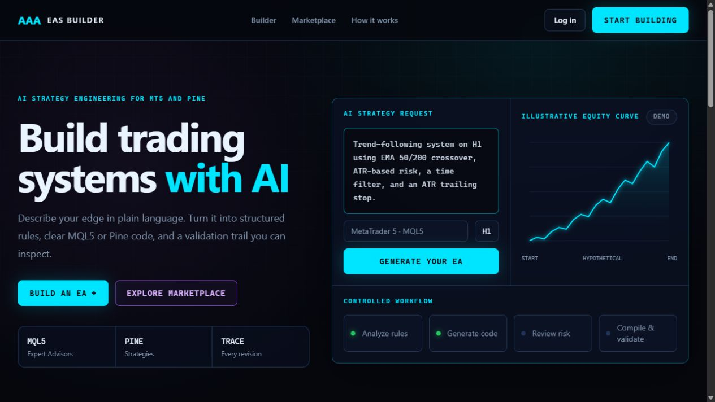
INVESTOR PRODUCT BRIEFING
AAA EAs
Builder
AI-native creation, repair, and evidence-first commerce for MT5 and TradingView.
WORKING MVP • AUGUST 2026
Confidential product overview
Notes:
Open with the core proposition: this is not a generic chatbot. It is a governed product workflow for turning trading logic into inspectable software and, later, distributing validated products.
[Sources]
- Internal: current local homepage capture
- Internal: README.md
[/Sources]

Slide 2
THE PROBLEM
Trading automation is powerful—but still difficult to build and trust
Most traders can describe an edge. Far fewer can safely turn it into maintainable code and credible evidence.
01 / ACCESS
02 / RELIABILITY
03 / TRUST
Ideas remain trapped in natural language
Debugging is slow and fragmented
Performance claims lack context
MQL5 and Pine expertise create a high barrier between strategy intent and executable software.
Prompts, code, compiler errors, revisions, and testing live in separate tools with weak continuity.
Metrics without test period, assumptions, drawdown, trade count, and verification status are hard to compare.
PRODUCT OPPORTUNITY
Unify creation, repair, validation, evidence, and distribution in one accountable workflow.
AAA EAs BUILDER
02
Notes:
Frame the problem as a workflow and trust gap rather than simply a lack of code generation. The product serves traders, independent developers, and marketplace operators.
[Sources]
- Internal: PROJECT_PLAN.md sections 1, 3, 4, and 7
[/Sources]

Slide 3
THE SOLUTION
One product turns an idea into inspectable trading software
A single lifecycle keeps intent, source, diagnostics, versions, and evidence connected.
01
02
03
04
05
06
Describe
→
Specify
→
Generate
→
Validate
→
Improve
→
Distribute
Plain-language rules
Structured strategy
MQL5 or Pine
Checks + compiler
Context-aware chat
Download or list
OUTPUTS
MT5 Expert Advisors
MT5 Indicators
Pine Strategies
Pine Indicators
Every result retains an explanation, assumptions, validation state, source hash, workflow snapshot, and revision history.
AAA EAs BUILDER
03
Notes:
Walk investors through the full customer loop. Distribution includes protected source downloads today and an evidence-first catalog; payments and entitlements are the next commerce milestone.
[Sources]
- Internal: README.md
- Internal: PROJECT_PLAN.md sections 2, 4, and 6
[/Sources]

Slide 4
LIVE PRODUCT
The customer experience is already product-shaped
LIVE LOCAL BUILD
Plain language in
Describe entries, exits, risk, sessions, and filters without writing code first.
Controlled workflow
Specialist agents and deterministic checks expose progress instead of hiding it behind one response.
Inspectable outputs
Users keep the source, version history, diagnostics, and download artifacts.
AAA EAs BUILDER
04
Notes:
This screenshot is from the current running application. Emphasize that the visual system and customer navigation are already integrated with the backend workflows.
[Sources]
- Internal: live local homepage capture
- Internal: templates/core/home.html
[/Sources]

Slide 5
AI GENERATION
A controlled agent workflow replaces the one-shot prompt
The MVP uses LangChain for provider/model abstraction and LangGraph for bounded, typed orchestration.
ARCHITECT
GENERATOR
REVIEWER
REPAIRER
Normalizes strategy logic
Writes platform code
Finds correctness risks
Applies bounded fixes
DETERMINISTIC GUARDRAILS
Typed outputs and versioned prompts
Source inspection and forbidden-pattern checks
Optional allowlisted MetaEditor compilation
Pinned workflow snapshot for reproducibility
Repair loop capped by policy and budget
Token and estimated-cost accounting
AAA EAs BUILDER
05
Notes:
The current published generation graph contains four specialist agents: architect, generator, reviewer, and repairer. Deterministic code performs schema and safety checks. This makes the workflow easier to govern than an open-ended agent swarm.
[Sources]
- Internal: apps/ai_config/services/default_workflow.py
- Internal: apps/builder/services/runtime.py
- Internal: README.md
[/Sources]

Slide 6
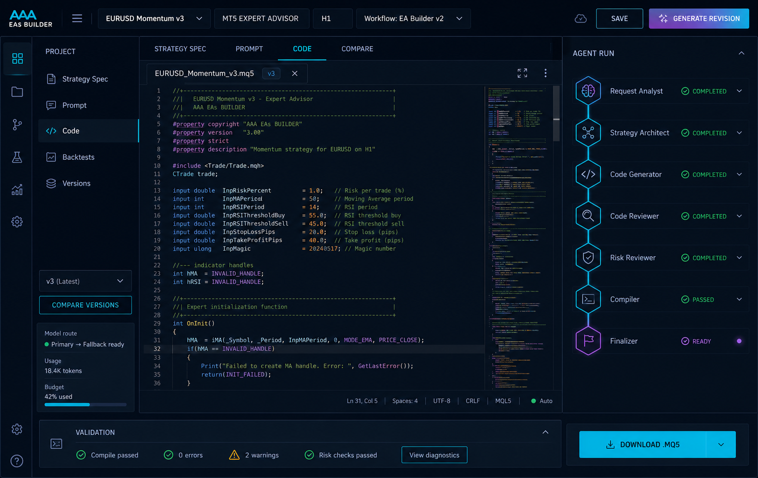
PROJECT-AWARE REPAIR
The copilot closes the loop on real code
FRESH CONTEXT PER ANSWER
WORKSPACE DIRECTION
Project rules + run progress
Pinned workflow snapshot
Latest complete source
Versions + diagnostics
Compiler output + recent chat
SAFE FIX WORKFLOW
1 Copilot proposes a complete file
2 Proposal stays tied to its base version
3 Apply creates a new immutable version
AAA EAs BUILDER
06
Notes:
The new project-aware copilot is the key continuity feature. It can explain failures, answer questions, and propose full corrected source. It never silently overwrites code: application is explicit and creates a new version that is revalidated.
[Sources]
- Internal: apps/builder/services/chat.py
- Internal: apps/builder/services/revisions.py
- Internal: templates/builder/partials/generation_chat.html
- Internal: docs/design/mockups/builder-workspace-v1.png
[/Sources]

Slide 7
VALIDATION
Trust is a product feature, not a disclaimer
Each state is labeled separately so AI review, static validation, compilation, and backtests are never conflated.
LEVEL 1
Source inspection
Required functions, size limits, forbidden patterns
IMPLEMENTED
LEVEL 2
Structural diagnostics
Platform-aware checks and structured warnings
IMPLEMENTED
LEVEL 3
MQL5 compilation
Isolated allowlisted MetaEditor worker
OPTIONAL
LEVEL 4
Declared backtest
Data, spread, dates, settings, and evidence lineage
ROADMAP
Safety boundary: generated code is downloaded for controlled testing; it is not executed inside the web application.
AAA EAs BUILDER
07
Notes:
Investors should understand that trust comes from explicit evidence levels. MQL5 compilation is available only when a dedicated Windows worker is configured. Automated Pine compilation and full backtesting are not claimed in the current MVP.
[Sources]
- Internal: README.md Optional MQL5 compiler
- Internal: PROJECT_PLAN.md validation levels and safety boundaries
- Internal: apps/builder/services/compiler.py
[/Sources]

Slide 8
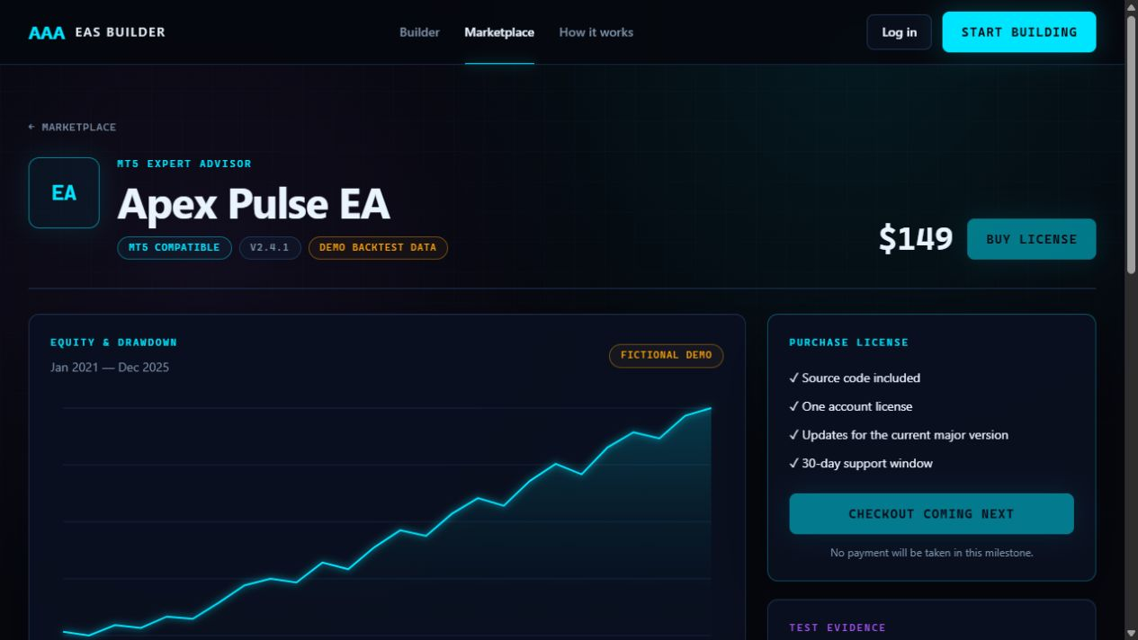
COMMERCE
The marketplace monetizes reusable automation with visible evidence
EVIDENCE BEFORE PURCHASE
FICTIONAL DEMO DATA
Profit factor, win rate, drawdown, trades
Test period and modelling assumptions
Verification state and report lineage
Equity and drawdown visualization
Version, compatibility, support, source policy
NEXT COMMERCE MILESTONE
Checkout → order → entitlement → protected download
AAA EAs BUILDER
08
Notes:
The catalog and product evidence experience are implemented. The screenshot uses explicitly fictional demo data. Checkout, orders, entitlements, and license delivery are intentionally deferred to the next milestone.
[Sources]
- Internal: live local marketplace product capture
- Internal: apps/marketplace/models.py
- Internal: README.md
[/Sources]

Slide 9
UNFOLD ADMIN
The admin panel is the product’s operating system
A private Django Unfold console controls AI supply, workflow policy, product operations, and evidence governance.
AI SUPPLY
REASONING
OPERATIONS
COMMERCE
Gateways + encrypted keys
Versioned system prompts
Users + projects
Products + pricing
Provider/model identifiers
Agent definitions
Runs, tokens, cost
Publishing status
Budgets, priority, health
Typed schemas + limits
Code versions + diagnostics
Test evidence
Fallback + capabilities
Published workflows
Chat + proposals
Verification labels
Governance by design: write-only secrets • versioned publishing • searchable audit records • existing runs keep pinned configuration
AAA EAs BUILDER
09
Notes:
This is where a small operations team can manage the entire system without a separate internal tool. API credentials are encrypted and write-only after entry. Prompts, agents, and workflows are versioned; active generations retain their pinned snapshot.
[Sources]
- Internal: apps/ai_config/admin.py and models.py
- Internal: apps/builder/admin.py
- Internal: apps/marketplace/admin.py
- Internal: apps/accounts/admin.py
[/Sources]

Slide 10
DATA LINEAGE
Every generation carries an auditable chain of custody
The system records what was requested, what configuration ran, what code changed, and what evidence supports the result.
ADMIN
RUN
CODE
CHECKS
COPILOT
EVIDENCE
Published
config
→
Pinned workflow
snapshot
→
Version + source
hash
→
Diagnostics +
compiler output
→
Proposal tied to
base version
→
Test run +
verification
WHY INVESTORS SHOULD CARE
Reproducibility
Support & disputes
Quality analytics
Marketplace trust
This lineage becomes the foundation for safer iteration, customer support, model evaluation, and evidence-based merchandising.
AAA EAs BUILDER
10
Notes:
The chain of custody is a core data advantage. It enables later evaluation by model, prompt, agent version, diagnostic type, product type, and evidence quality without losing provenance.
[Sources]
- Internal: apps/ai_config/models.py
- Internal: apps/builder/models.py
- Internal: apps/marketplace/models.py
[/Sources]

Slide 11
ARCHITECTURE
Built for an MVP today—and production scale tomorrow
A modular Django core keeps the first release fast to ship while preserving clear upgrade paths.
EXPERIENCE
Django templates • Tailwind • HTMX • Alpine.js
APPLICATION
Class-based views • domain services • permissions • protected downloads
AI ORCHESTRATION
LangChain providers • LangGraph workflow • structured outputs
ASYNC + DATA
Celery • Redis • SQLite development → PostgreSQL production
OPERATIONS
Unfold admin • Docker • Windows BAT • Makefile
Deployment choice
Normal Windows workflow for local teams • Docker web/worker/Redis stack for consistent environments
AAA EAs BUILDER
11
Notes:
The architecture intentionally avoids an early split into multiple frontends or microservices. The current app runs locally without Docker and includes a containerized path. Production migration replaces SQLite with PostgreSQL and runs background work through Celery and Redis.
[Sources]
- Internal: README.md
- Internal: docker-compose.yml
- Internal: dev.bat
- Internal: Makefile
- Internal: config/settings/
[/Sources]

Slide 12
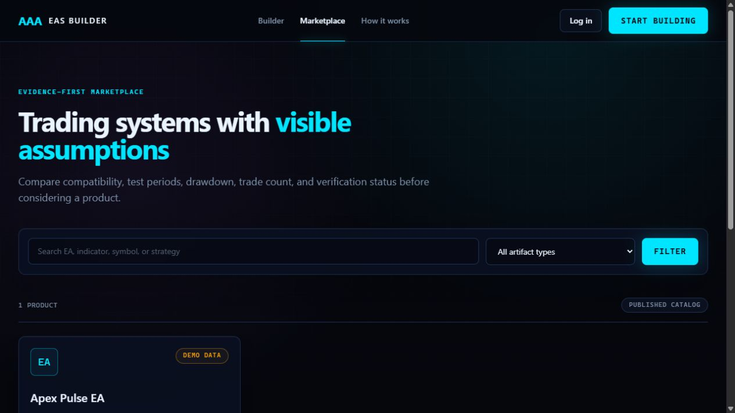
IMPLEMENTATION PROOF
The current MVP proves the core technical risk
4
artifact types
MT5 EA + indicator, Pine strategy + indicator
5
admin-managed AI agents
Four generation roles plus the project copilot
22
automated tests passing
Accounts, AI config, builder, core, and marketplace
LIVE
Gemini integration verified
A real fix proposal reduced internal diagnostics from 4 to 1
INTERNAL VERIFICATION—NOT CUSTOMER TRACTION
Implemented: authentication, projects, generation, versioned code, diagnostics, copilot proposals, admin AI configuration, catalog, evidence pages, and downloads.
AAA EAs BUILDER
12
Notes:
Be precise: these are product and engineering proof points, not revenue or customer traction. The live Gemini test created a full proposal and improved the diagnostic count, but still left one issue for another iteration; this is why the product retains validation and human application steps.
[Sources]
- Internal: automated test suite run on 2026-08-10
- Internal: live Gemini verification performed on 2026-08-10
- Internal: current local marketplace capture
- Internal: README.md
[/Sources]

Slide 13
PROPOSED BUSINESS MODEL
Revenue can combine creation, usage, and commerce
The same platform can monetize both software creation and distribution without depending on a single revenue stream.
SUBSCRIPTION
USAGE
MARKETPLACE
PREMIUM
Builder access
Advanced AI + validation
Transaction take rate
Vendor and team tools
Projects, saved versions, templates, and included monthly generations
Additional generation credits, premium models, compilation, and evidence services
Commission on licensed pre-made EAs, indicators, and strategy products
Higher limits, managed publishing, support, analytics, and governance
Pricing, take rate, and packaging remain to be validated with launch users; no revenue assumptions are presented here.
AAA EAs BUILDER
13
Notes:
Present this as a proposed model to test, not a finalized forecast. The sequencing can begin with subscriptions and usage, then add marketplace transactions once checkout and entitlements are complete.
[Sources]
- Internal: PROJECT_PLAN.md product vision and marketplace scope
- Internal product strategy assumption; not yet validated
[/Sources]

Slide 14
ROADMAP & CLOSE
The path from working MVP to investable launch is clear
NOW
0–3 MONTHS
3–6 MONTHS
6–12 MONTHS
Core workflow proven
Production launch
Evidence engine
Marketplace scale
AI generation + repair
Checkout + entitlements
Report ingestion + parsing
Seller onboarding + payouts
Versioned code + validation
PostgreSQL + observability
Backtest provenance
Optimization/forward tests
Admin AI control plane
Email/account hardening
Guided templates
Team and vendor tools
Evidence-first catalog
Isolated compile worker
Initial seller pilot
Distribution partnerships
INVESTOR CONVERSATION
Capital accelerates production hardening, evidence infrastructure, payments, and launch distribution.
AAA EAs BUILDER
14
Notes:
Close by asking for feedback and alignment on the next financing milestone. The specific round size and financial projections should be added only after the founder defines the raise, runway, hiring plan, and customer-validation targets.
[Sources]
- Internal: PROJECT_PLAN.md roadmap and deferred scope
- Internal: README.md current vs deferred capabilities
[/Sources]

